Slide 1
1.
INTRODUCTION TO
POLYMER BLENDING

Slide 2
Size of final
polymer particles
( 0.1 to 5 µm;
10 to 100 nm)
Size of initial
polymer pellets
( 1 to 5 mm)
Twin screw extruder
Flow, melting, mixing, reaction, structuring
A continuous process
Short residence times ( < 60 s)
Throughput of a few tons per hour

Slide 3
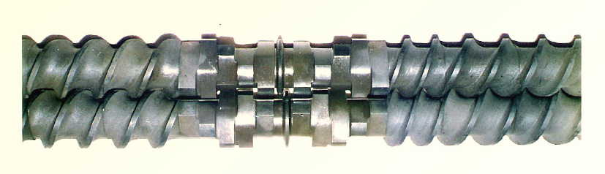
Twin screw extruders

Slide 4
The geometry of kneading discs and flow channel
KD1: 45/5/32
KD2: 60/4/32
KD3: 90/5/32
KD4: 90/10/64
KD5: 90/5/64
Flow channel

Slide 5
MORPHOLOGY
Morphology = f(Mixing, Compatibilizer)
Block
copolymer
Graft
copolymer

Slide 6
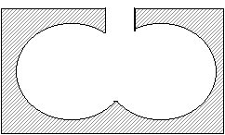
A BATCH MIXER

Slide 7
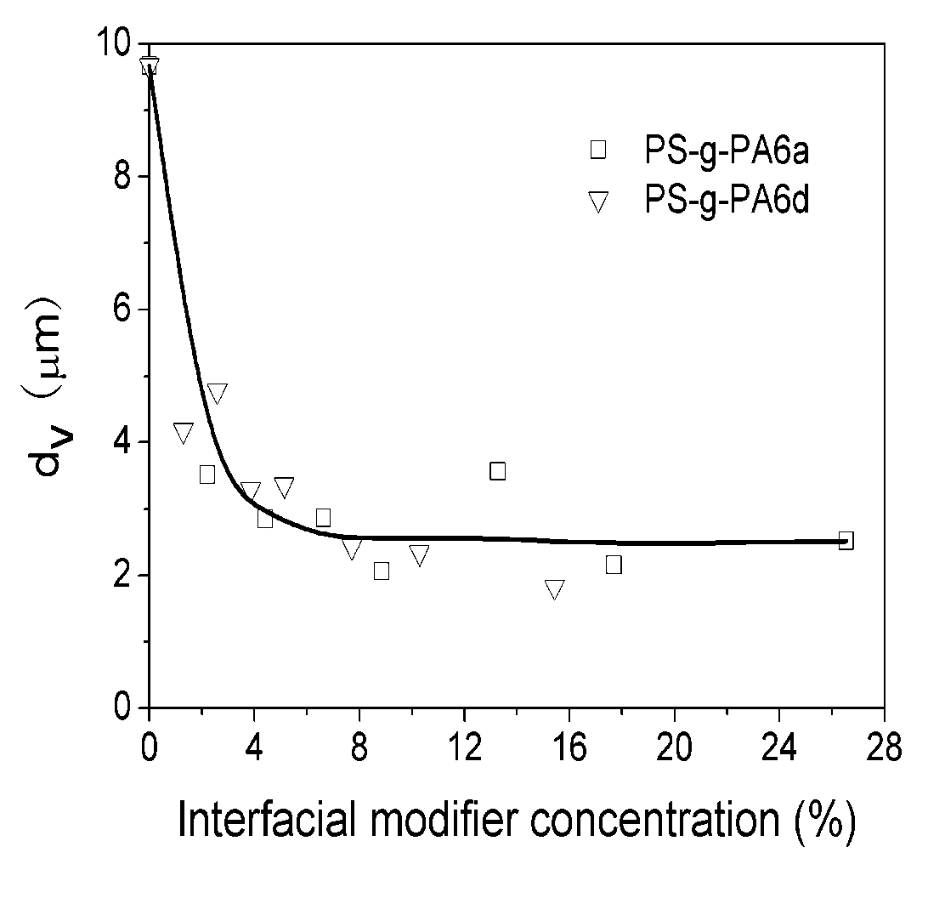
Emulsification curve
PS/PA6
Blend:
1000 kg/h
Compatibilizer:
>10 kg/h
Construction of an emulsificaiton curve
is tedious and material-consuming,
especially for industrial processes.

Slide 8
2.
CONCEPT OF
COMPATIBILIZER-TRACER

Slide 9
Concept of compatibilizer-tracer
Fluorescent moities
Zhang, Cai-Liang; Feng, Lian-Fang; Hoppe, Sandrine;
Hu, Guo-Hua. AIChE Journal (2009), 55, 279-283.
Zhang, Cai-Liang; Feng, Lian-Fang; Hoppe, Sandrine;
Hu, Guo-Hua. AIChE Journal (2012), 58,1931-1928.

Slide 10
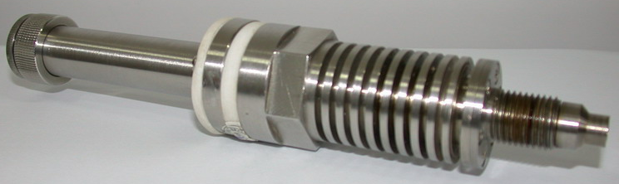
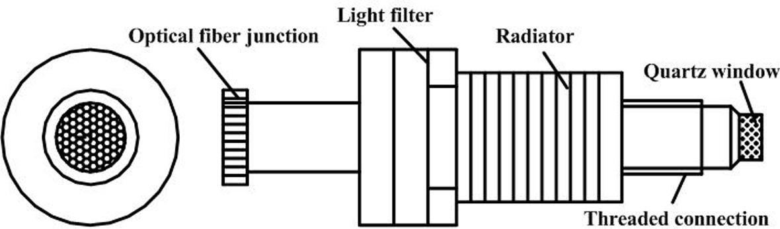
Schematic of a fluorescent
bifurcated optical probe

Slide 11
(a) Non-reactive blending processes

Slide 12
RTD and dispersed domain
size distribution (DSD)
PS-g-PA-tracer
PS+PA6
RTD
Screw extruder
DSD

Slide 13
RTD
DSD

Slide 14
An emulsification curve
from RTD & DSD
Short time domain
Long time domain
Unique feature:
two curves that
form a closed loop.

Slide 15
Concept of compatibilizer-tracer
Construction of emulsification curves
for industrial polymer blending processes
Molecular design of the compatibilizer
Mixing assessement
Process design
Process optimization

Slide 16
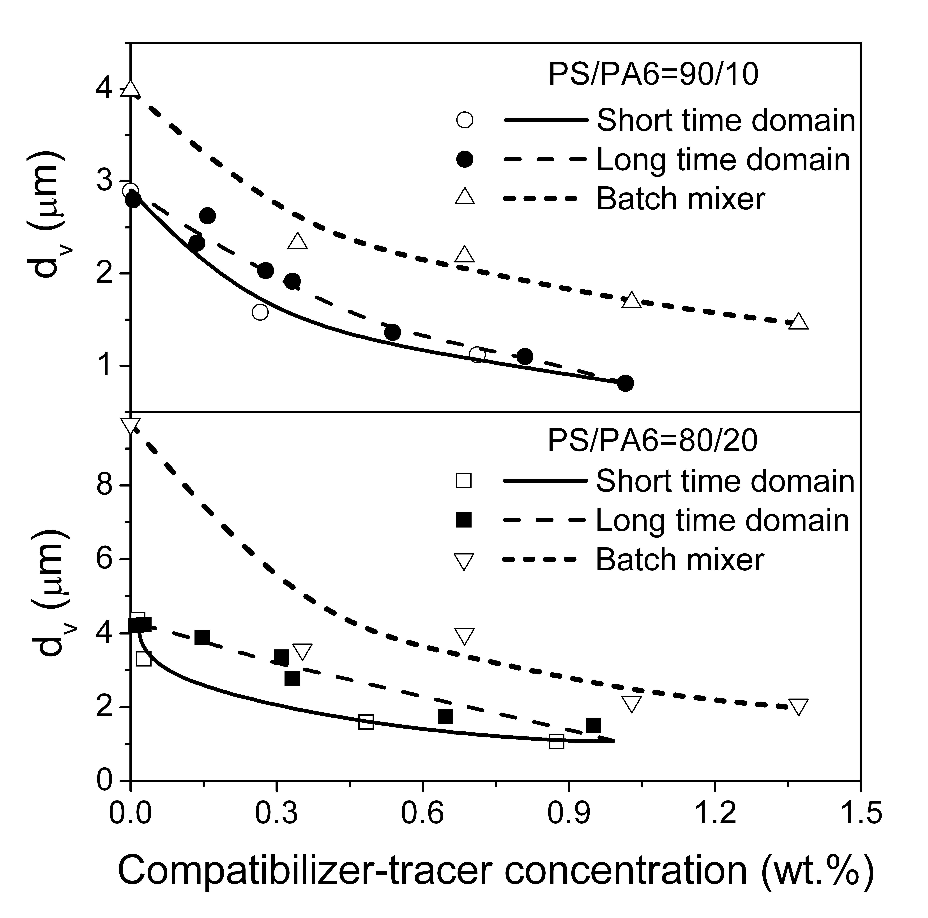
Comparison between two mixers

Slide 17
Effect of screw speed on
the emulsification curve

Slide 18
(b) Reactive blending processes

Slide 19
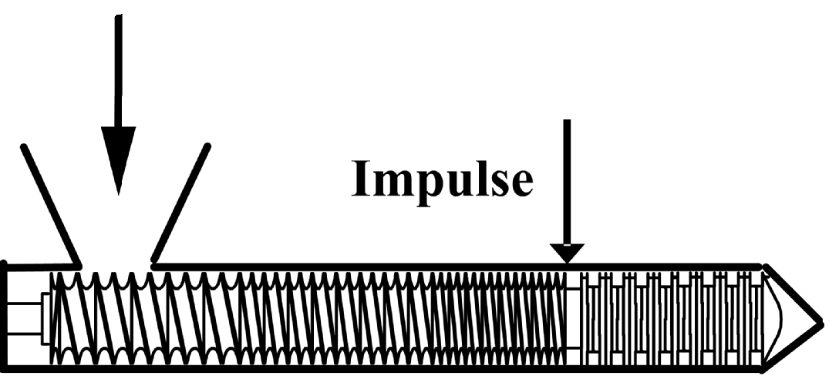
PS/PA6
PS-co-TMI-Ant
PS
Reactive compatibilizer-tracer
PS-co-TMI-Ant
N
C
O
N
C
O
PA6-NH₂
Interfacial Reaction
PS-g-PA6 graft copolymers

Slide 20
A
B
1 to 5 nm

Slide 21
RTD
DSD

Slide 22
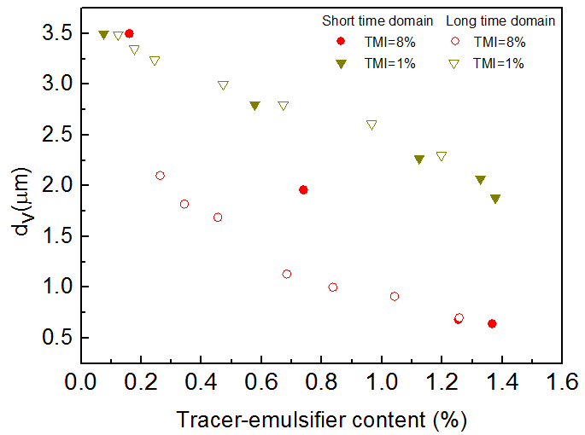
Two PS-TMI-Ant with 1% and 8% TMI

Slide 23

Two reactive compatibilizers with different reactive groups
Anh-PS-Ant
N
C
O
N
C
O
PS-co-TMI-Ant
Notes:
This slice compared the efficiency of block or graft copolymer as tracer. The molecular structures of two reactive tracer-emulsifier show in left figure. Emulsification curve corresponding to the long time domain is above the one corresponding to short time domain for Anh-PS-Ant as tracer-emulsifier; while emulsification curves for PS-co-TMI-Ant as tracer-emulsifier are almost superposition. This indicated that the reaction of PS-co-TMI-Ant with polyamide 6 is faster than that of Anh-PS-Ant.

Slide 24
4.
CONCLUSIONS
AND
FUTURE WORK

Slide 25
Concept of compatibilizer-tracer
(reactive or not)
Construction of emulsification curves
for industrial polymer blending processes
Molecular design of the compatibilizer
Assessement of mixing mechanisms
mixing efficiency
Modeling & model validation
Design of screw profile & proces
Process optimization

Slide 26
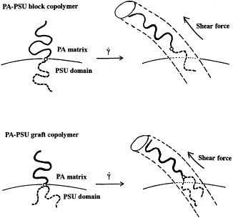
Flow-induced copolymer pull-out
Inoue et al.

